Slide 1
Optimizing the placements of 360’ panorama cameras in indoor environments
Syuan-Rong Syu and Chi-Han Peng
National Yang Ming Chiao Tung University, Taiwan
Notes:
Good afternoon everyone, this is Chi-Han from National Yang Ming Chiao Tung University in Taiwan. My student Syuan Rong Syu and I will introduce our paper about finding optimal placements of 360-degree cameras in indoor environments.

Slide 2
Motivation: panoramas
A single panorama encodes full 3DOF virtual reality (i.e., perspective views of arbitrary directions, orientations, and FOVs) at a fixed camera position.
Photo: https://sektor.build/openspace https://3dmart.com.tw/news/matterport-pro2-3d-scanner-unpacking-and-test https://ca.news.yahoo.com/matterport-3d-capture-now-freely-131500655.html
Notes:
In the Architectural, Engineering, and Construction industries, or AEC in short, an important need is to record and document the progress of constructions over time by taking a lot of photos of the indoor environments. A trend is to replace traditional cameras with 360-degree cameras, as it usually needs far fewer panoramas to fully capture an indoor environment than traditional perspective photos.
Similarly, in real-estates and retail, “virtual tour” applications allow users to virtually visit a property without physically being there. The current dominant way for doing so is through panoramas with camera poses in between, so the user can have full 3DOF virtual reality at the fixed locations and intuitively jump or “teleport” between the locations using UIs such as clickable markers.

Slide 3
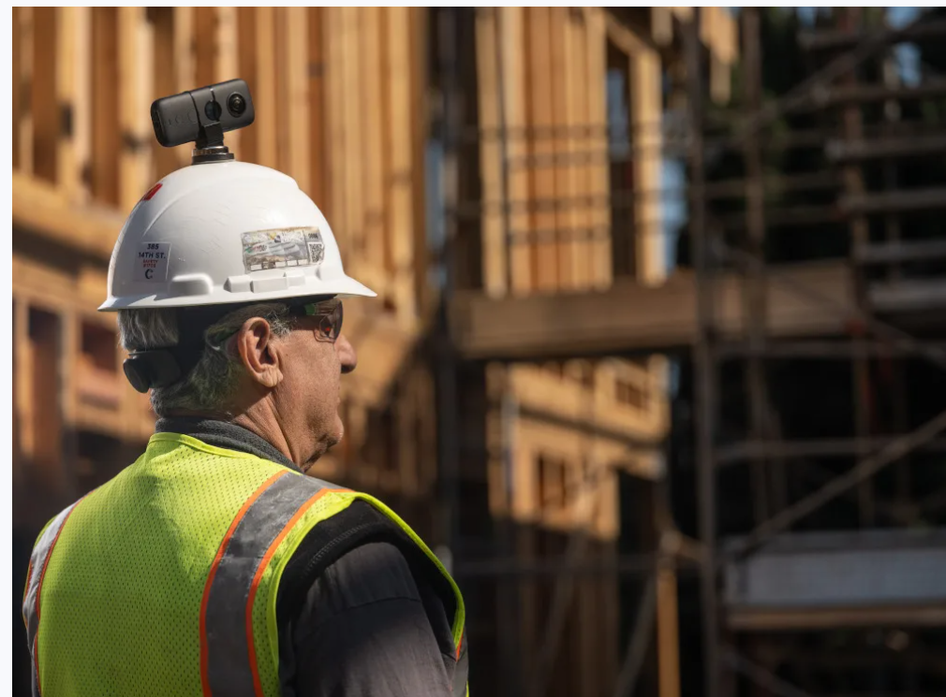
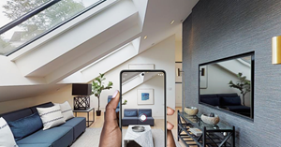
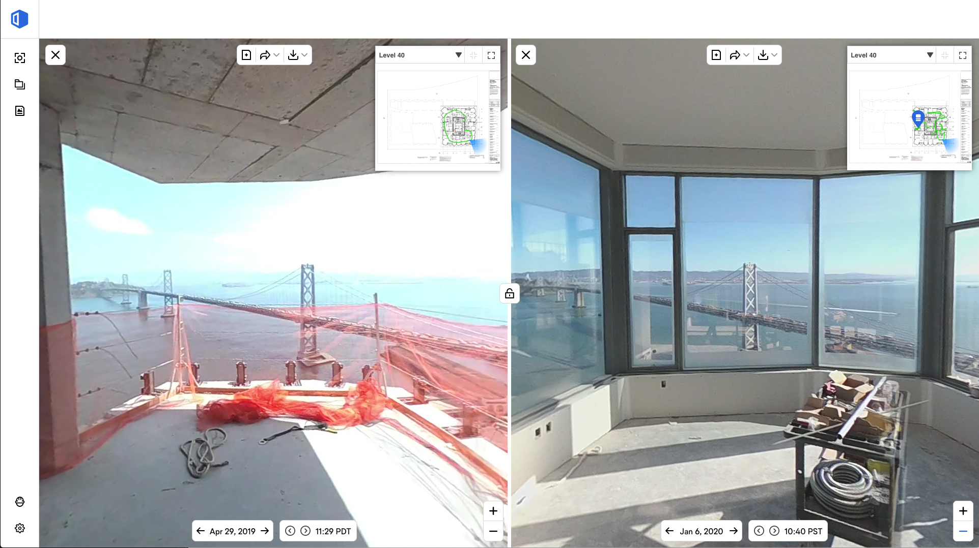
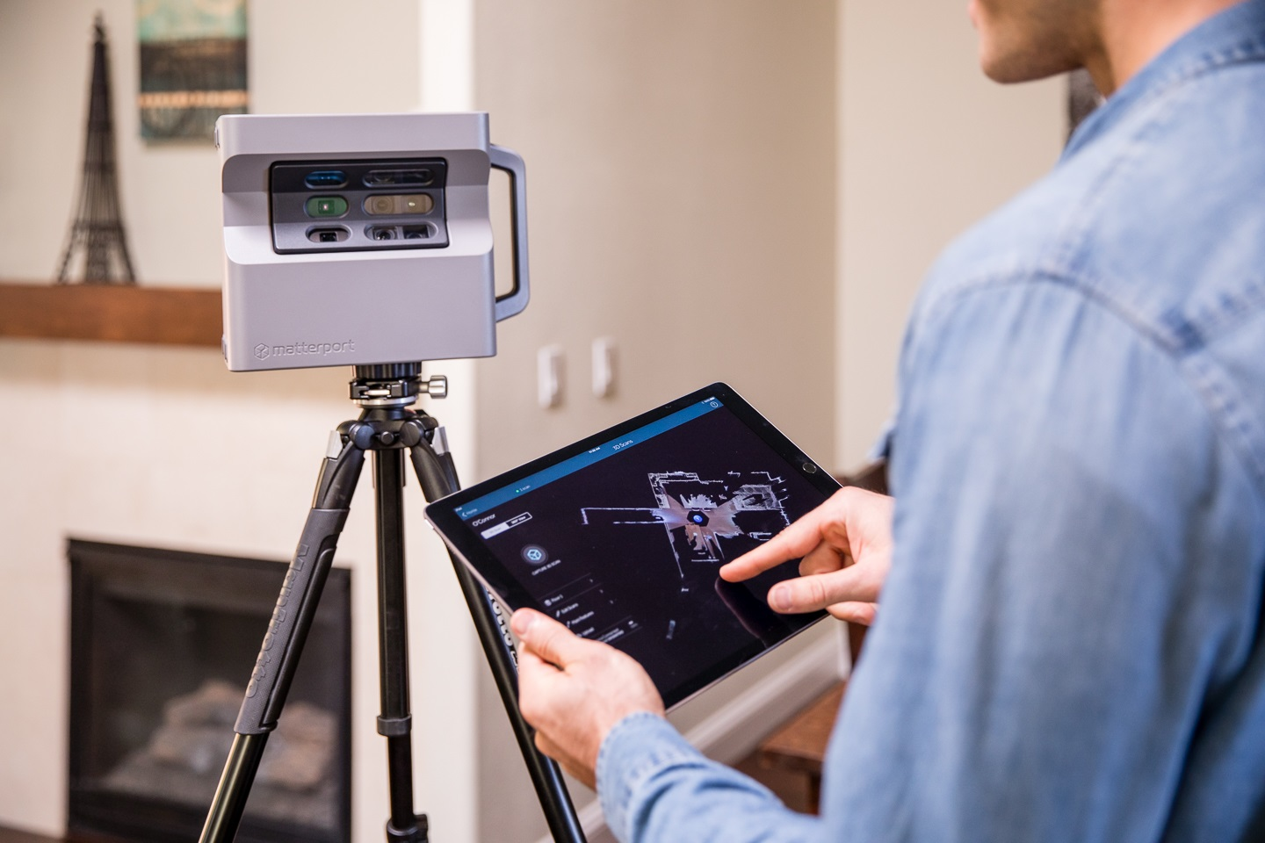
Motivation: trends in indoor/building environments documentation
OpenSpace Co.
Matterport Co.
Photo: https://sektor.build/openspace https://3dmart.com.tw/news/matterport-pro2-3d-scanner-unpacking-and-test https://ca.news.yahoo.com/matterport-3d-capture-now-freely-131500655.html
Notes:
In the Architectural, Engineering, and Construction industries, or AEC in short, an important need is to record and document the progress of constructions over time by taking a lot of photos of the indoor environments. A trend is to replace traditional cameras with 360-degree cameras, as it usually needs far fewer panoramas to fully capture an indoor environment than traditional perspective photos.
Similarly, in real-estates and retail, “virtual tour” applications allow users to virtually visit a property without physically being there. The current dominant way for doing so is through panoramas with camera poses in between, so the user can have full 3DOF virtual reality at the fixed locations and intuitively jump or “teleport” between the locations using UIs such as clickable markers.

Slide 4
Industry example: OpenSpace.ai
https://blog.insta360.com/openspace-insta360-integrate-for-construction-photo-documentation-during-covid-19/
Notes:
To demonstrate the usefulness of using panoramas in the AEC industries, we share a very interesting video by OpenSpace.ai. This video shows that engineers use 360-degree cameras, mounted on their helmet, to capture a construction jobsite by simply walking in it. We can see that the panoramic footages enable applications such as communications between different stakeholders (something like BIM), documenting the construction progress over time, and even simulations of alternative setups of the indoor environments.

Slide 5
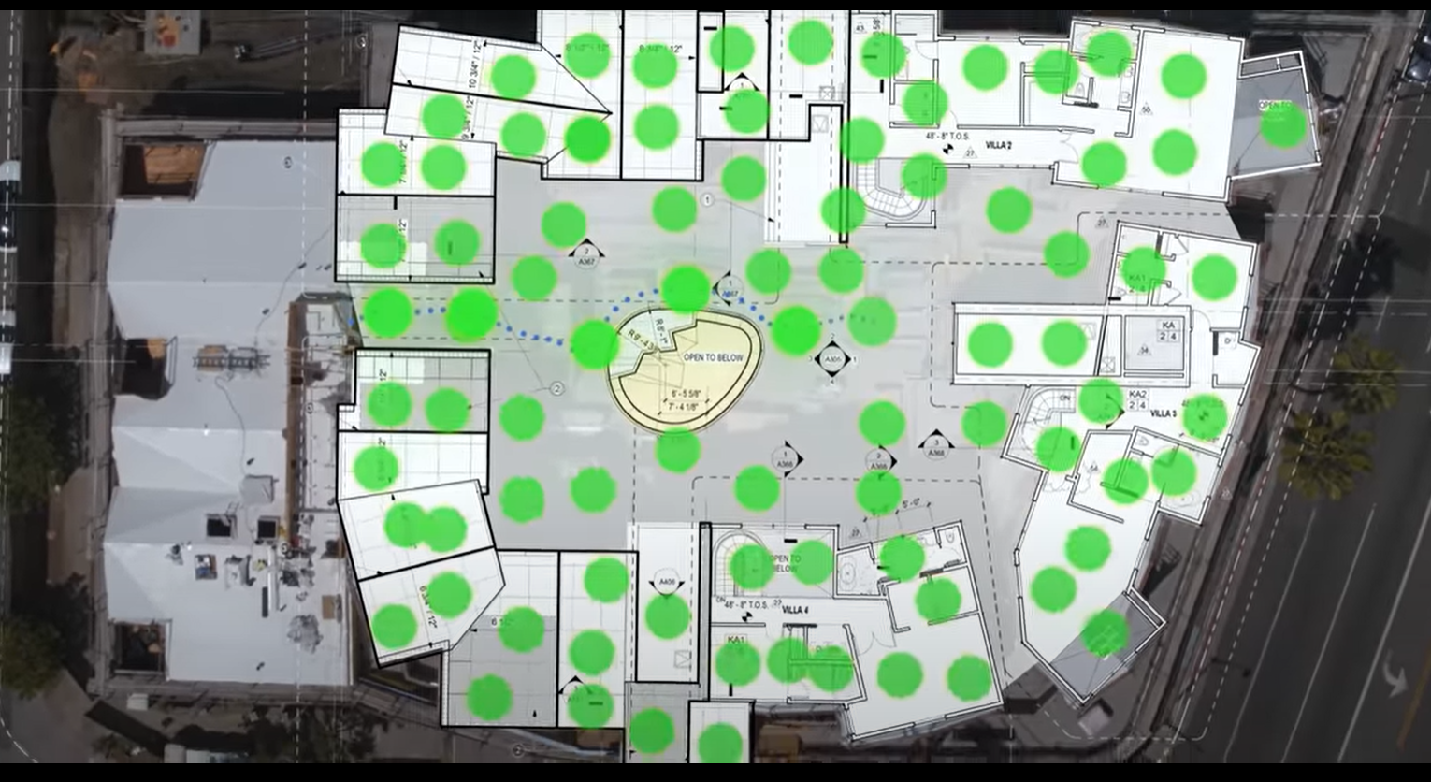
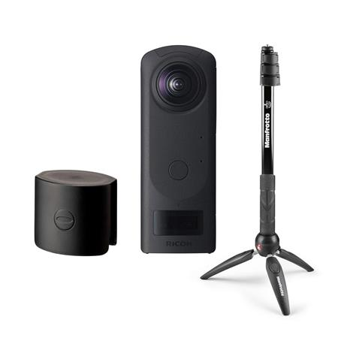
https://matterport.com/cameras/pro2-3D-camera
https://www.openspace.ai/
5
Notes:
While we find their tools to be clever and useful, we do observe one weakness - which is the large numbers of panoramas that are taken.
While this is more ok for helmet-held 360-degree cameras that capture panoramic videos, for more high-quality 360 photography or 3D scans, the camera or the 3D scanner needs to be mounted on a steady tripod; and placing and moving the tripod becomes a time-consuming process. Therefore, we want to propose a computational approach to help the photographers to plan optimal placements of the 360 camera (in terms of numbers of panoramas taken) in an indoor environment so that time and efforts can be minimized.

Slide 6
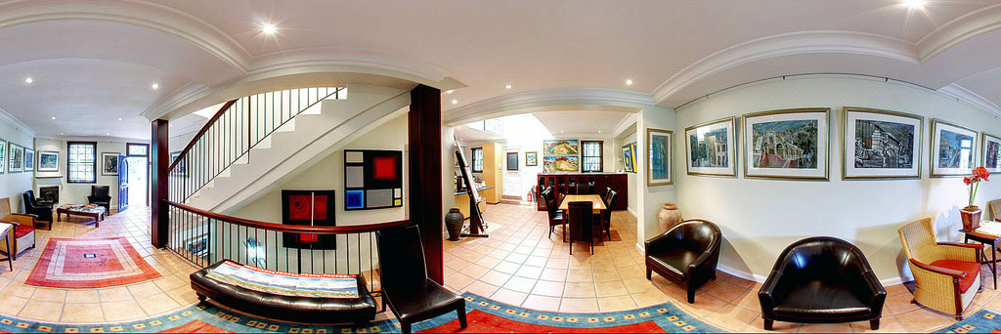
Challenges with $360°$ camera shooting:
Occlusions.
Visible ranges.
Distortions – when seeing at “slanted” angles.
RICOH Theta Z1
https://blog.insta360.com/openspace-insta360-integrate-for-construction-photo-documentation-during-covid-19/
Notes:
While using panoramas can greatly reduce the number of photos needed to capture an indoor environment, there are still several challenges when we do so. The first is obviously the occlusions caused by walls and large objects. Even if there are no occlusions, the relatively weaker spec of 360-cameras over traditional cameras means that the visible ranges, which is usually less than 10 meters long, and distortions when seeing walls at “slanted” angles, needs to be considered.

Slide 7
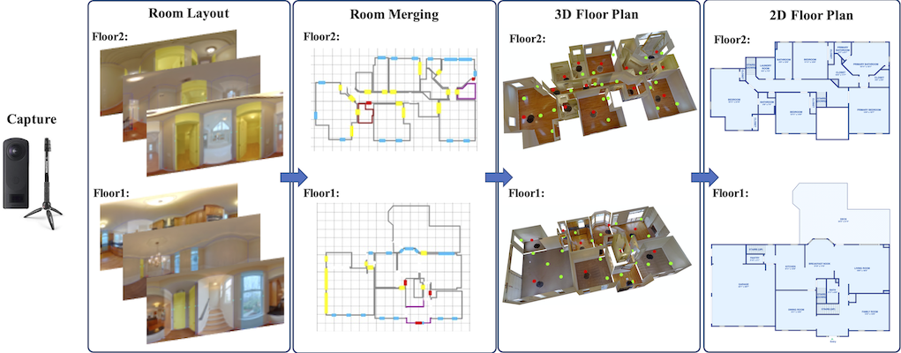
Related Work - 360◦ camera placement guidelines
Zillow Indoor Dataset (ZInD)
https://github.com/zillow/zind
S. Cruz, W. Hutchcroft, Y. Li, N. Khosravan, I. Boyadzhiev, and S. B. Kang, “Zillow indoor dataset: Annotated floor plans with 360º panoramas and 3d room layouts,” in Proceedings of the IEEE/CVF Conference on Computer Vision and Pattern Recognition (CVPR), June 2021, pp. 2133–2143.
Notes:
A simple guide to placing 360° cameras for virtual tours is described in the Zillow Indoor Dataset (ZInD) , a unique attribute of this paper is the room layout profile.
ZInD follows a real-world distribution rather than most cuboid or Manhattan layouts in currently available datasets.
This means that panoramic photos should be taken in larger rooms.

Slide 8
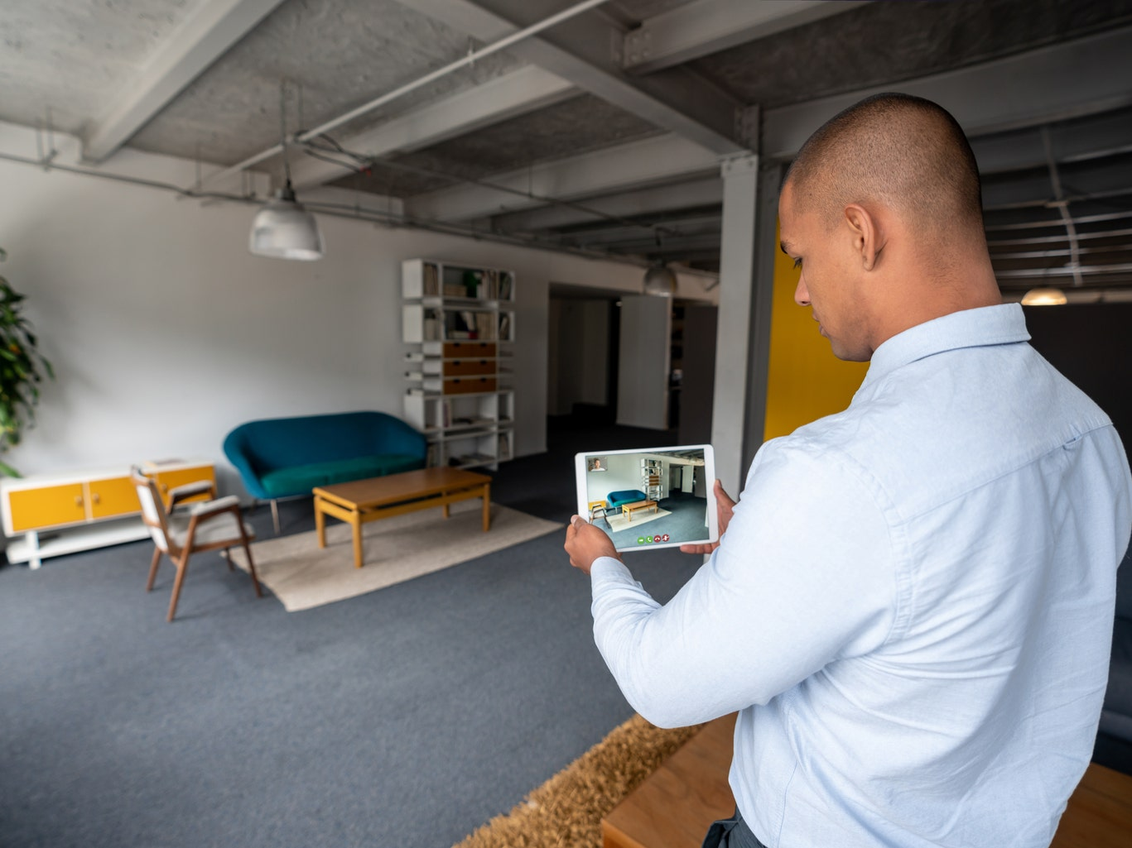
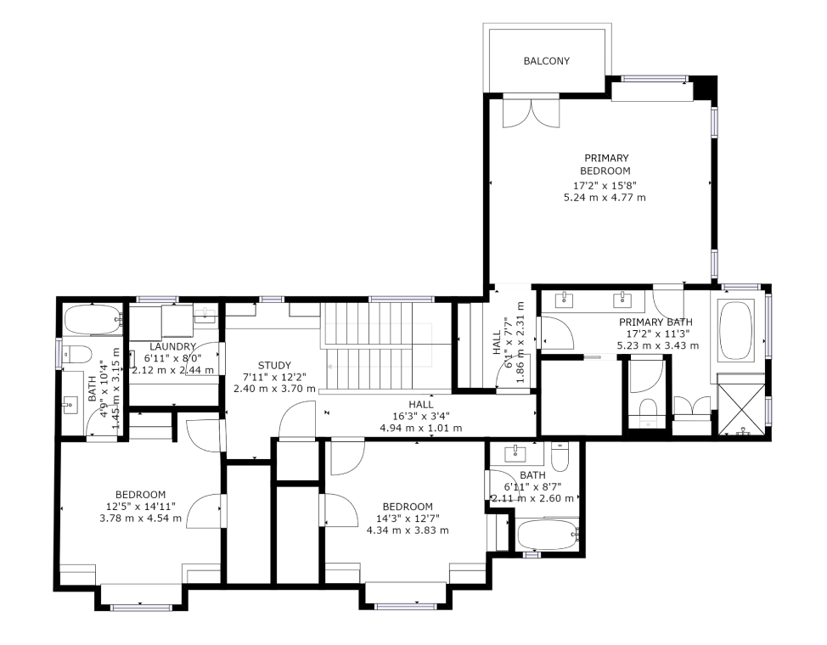
Matterport's guide for construction documentation
Create a 2D drawing or floor plan of the site to plan the path in advance.
Taking panoramas in the middle of the room
and detailed 3D scans around the perimeter.
https://matterport.com/how-it-works/schematic-floor-plans
https://seekingalpha.com/article/4482283-matterport-missed-golden-opportunity-covid19
Notes:
• Create 2D drawings or floor plans of the site to plan paths in advance.
• Physical markers were previously placed on the 360° camera for easy re-access.
• Capture panoramas in the center of the room and detailed 3D scans around the perimeter.

Slide 9
Related Work - Automatic camera placement

Slide 10
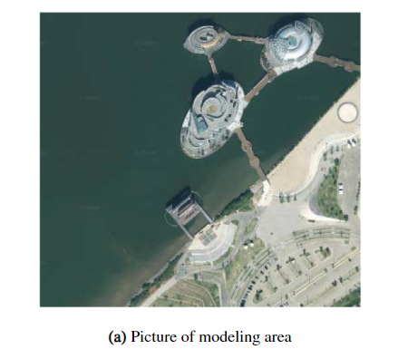
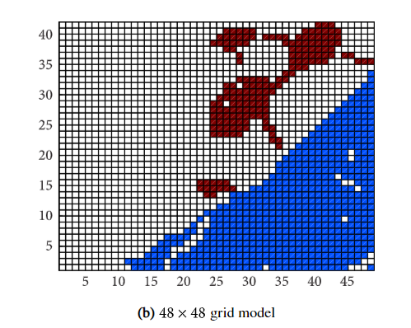
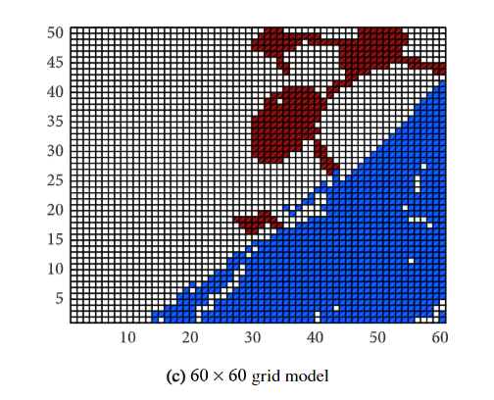
Related Work - Integer programming in solving optimized problems

Slide 11
Overview
Pre-modeled the floor plan of the building - Encode the indoor clutter-free environment as a 2.5D model
Minimize the number of panoramas be taken together
ROI: Region of Interests

Slide 12
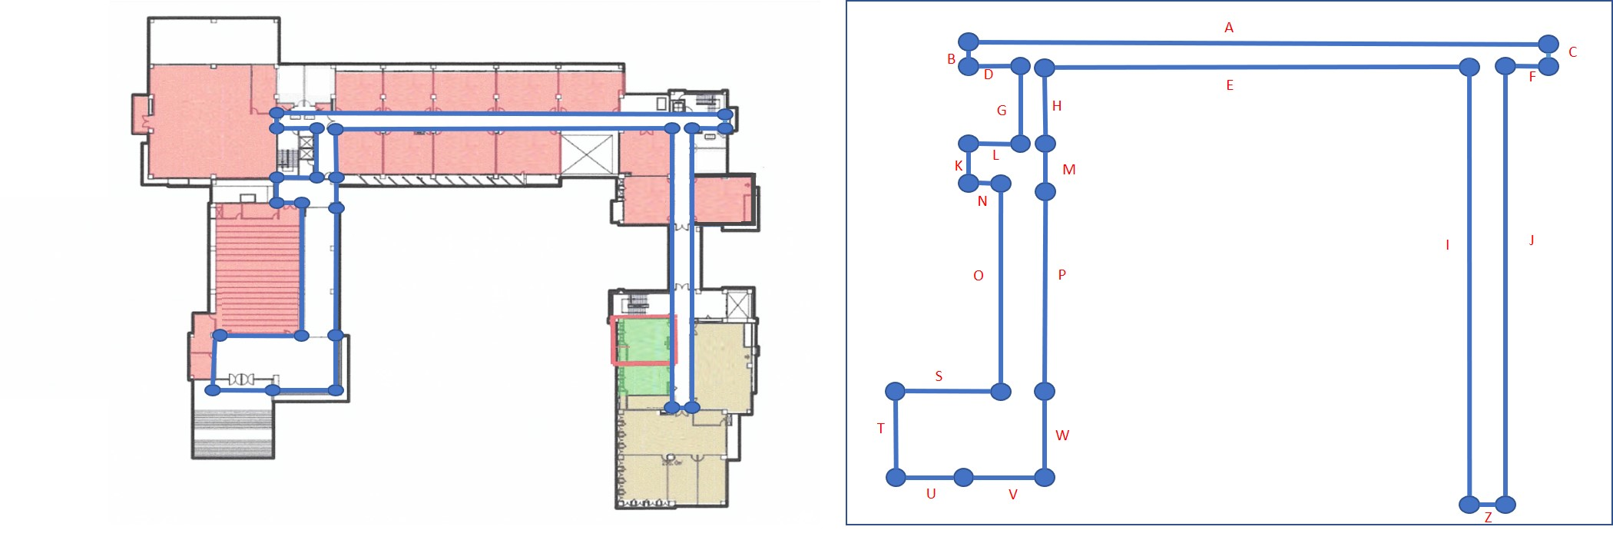
Method
Set the virtual environment
Define the ROIs to be the walls of the indoor environment only.
Notes:
Define the ROIs to be the walls of the indoor environment only (excluding the floor and the ceiling).

Slide 13
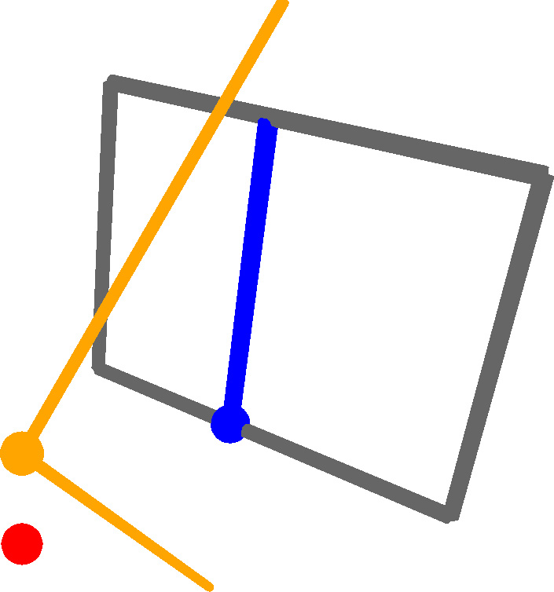
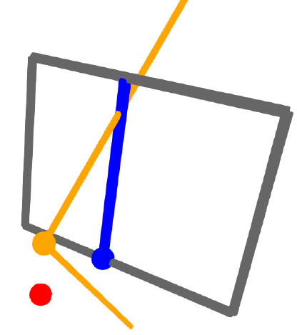
Assume the distance from a 360◦ camera to a wall is not smaller than:
FOVy : the vertical field-of-view angle of the 360◦ camera.
h : the bigger value of the camera heights to the floor and to ceiling.
A 2D point (blue)
on the floor plane
The camera in 3D
An example where the camera is too close to the wall.
Encoded as a 2D point
on the floor plane

Slide 14
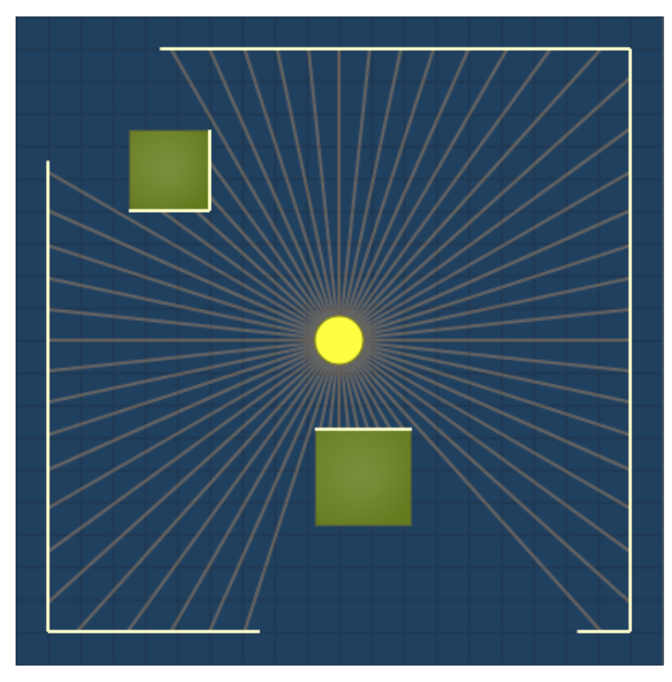
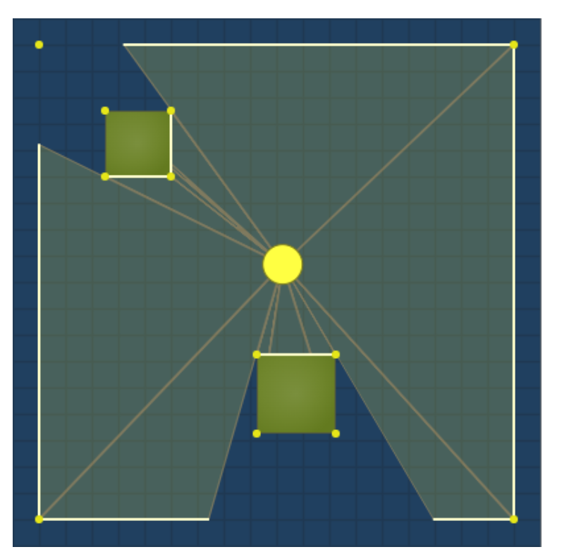
Visibility triangle
Ray casting
1. Calculate the angles where walls begin or end.
2. Cast a ray from the center along each angle.
3. Fill in the triangles generated by those rays.
Wall tracking
Sweeps a line around a circle, hitting all the points sorted by angle.
https://www.redblobgames.com/articles/visibility/

Slide 15
Optimized by integer programming

Slide 16
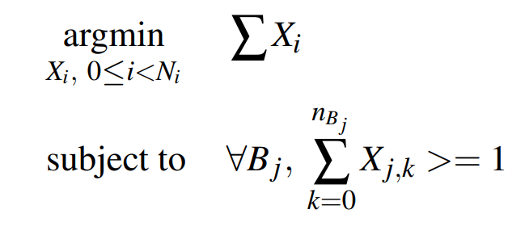
Use the optimal solver after the test as stated above and formulating the visibility problem as a linear integer programming (IP) problem:
Denotes a Boolean variable indicating whether a 360◦ camera is placed at Ii (the ith interior point)
Xj,k, 0 ≤ k < nBj : Enumerate the Boolean variables of potential camera placements at interior points that cover boundary point Bj, nBj is the number of such interior points.
Notes:
Xi : denotes a Boolean variable indicating whether a 360◦ camera is placed at Ii (the ith interior point).
Xj,k, 0 ≤ k < nBj, enumerate the Boolean variables of potential camera placements at interior points that cover boundary point Bj, nBj is the number of such interior points.

Slide 17
Result
For the minimal range, we find that the camera cannot get closer than 0.61 meters to a wall because the tripod needs space.
Max distance
+
Angle(<45’)
No limit
Max distance

Slide 18
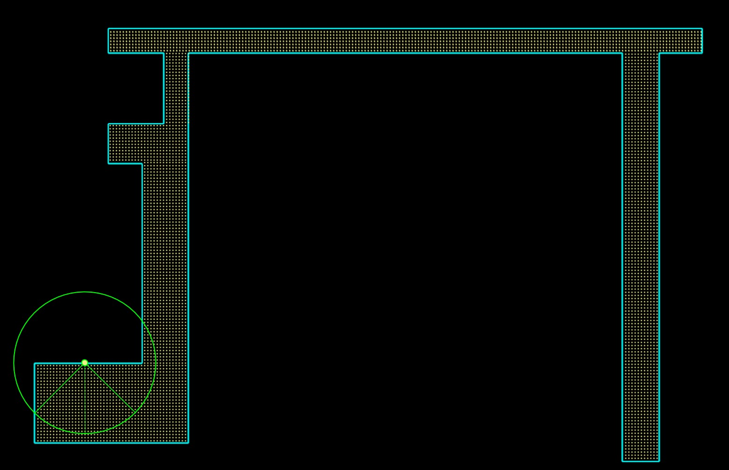
Visible range
We also show the set of interior points that cover a boundary point as the ones within the 90-degree quadrant.
The sampled boundary and interior points.
Notes:
We densely sampled 1056 boundary points and 19248 interior points .
This means that the visibility matrix (as used to describe problem sizes) has about 20.326 million entries, which is bigger than the problems .

Slide 19
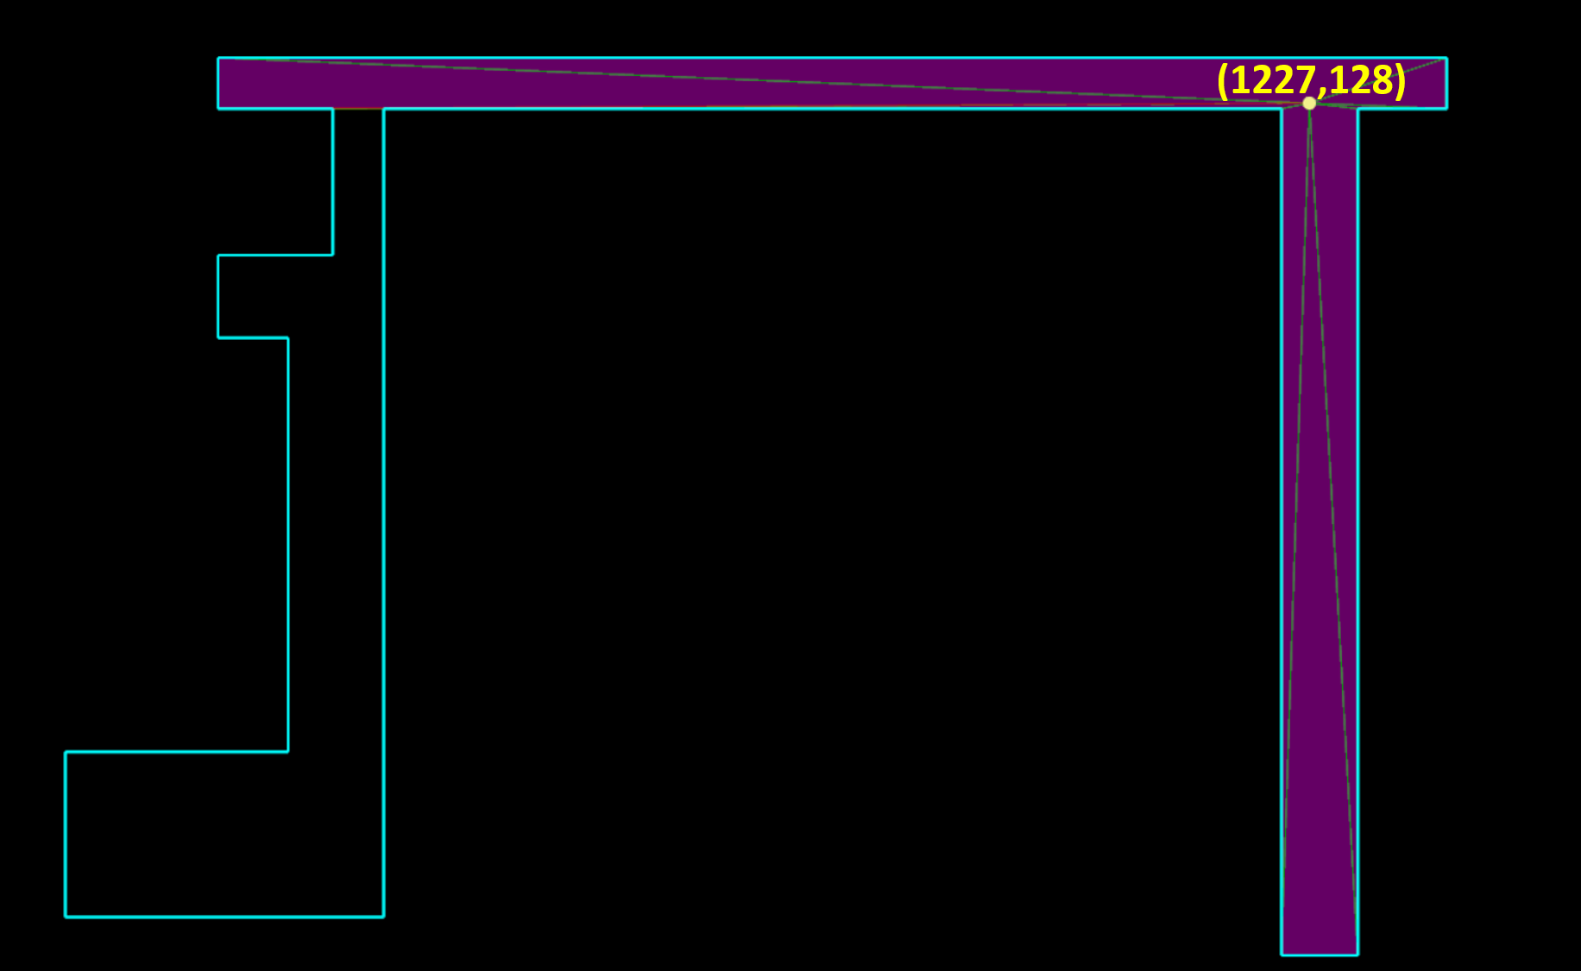
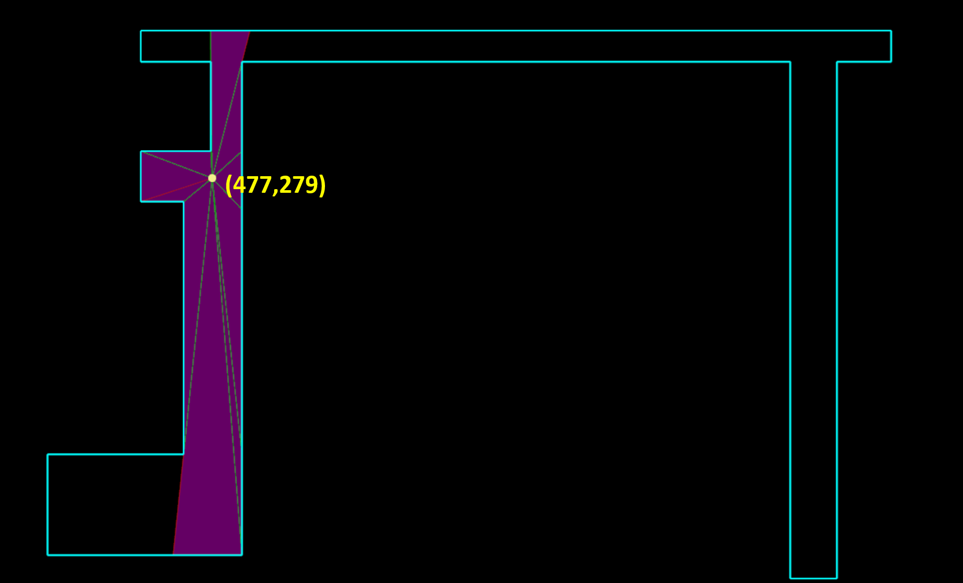
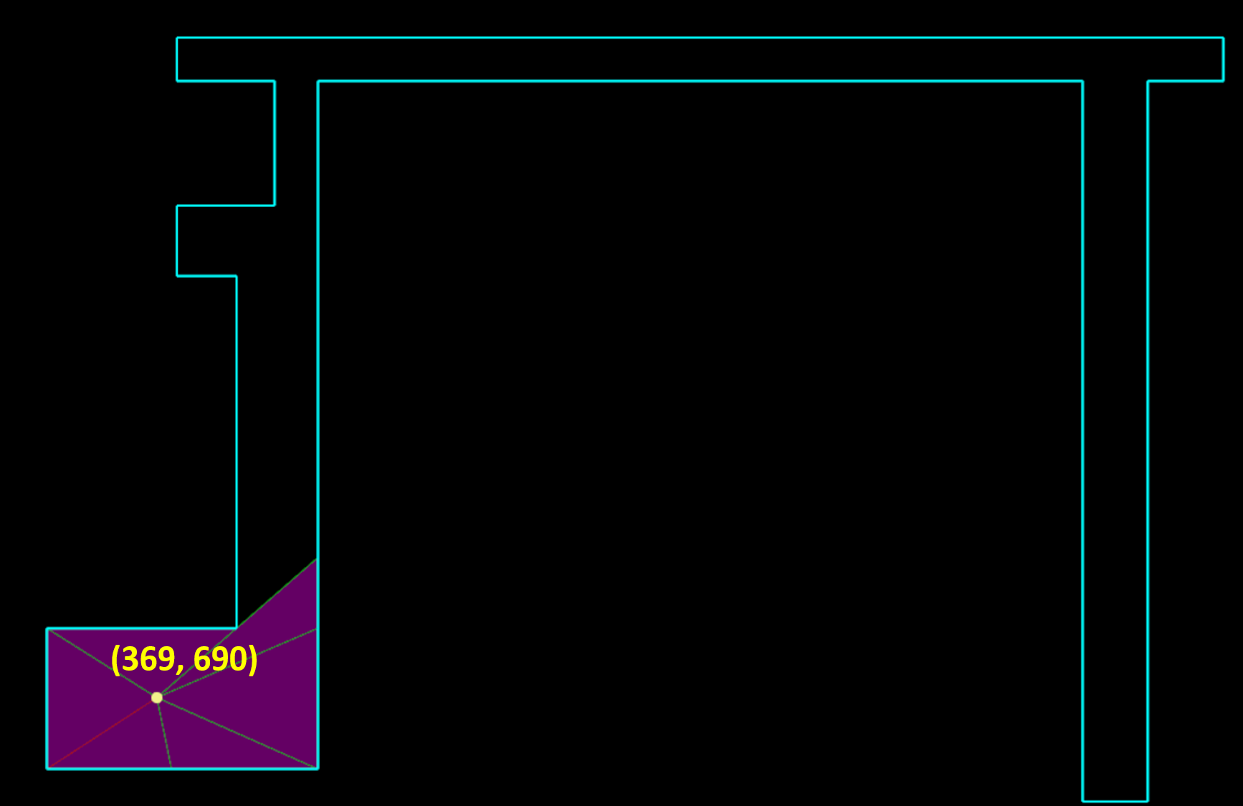
Coverages of the three 360◦ cameras that together completely cover the whole indoor environment in the non-constrained problem.

Slide 20
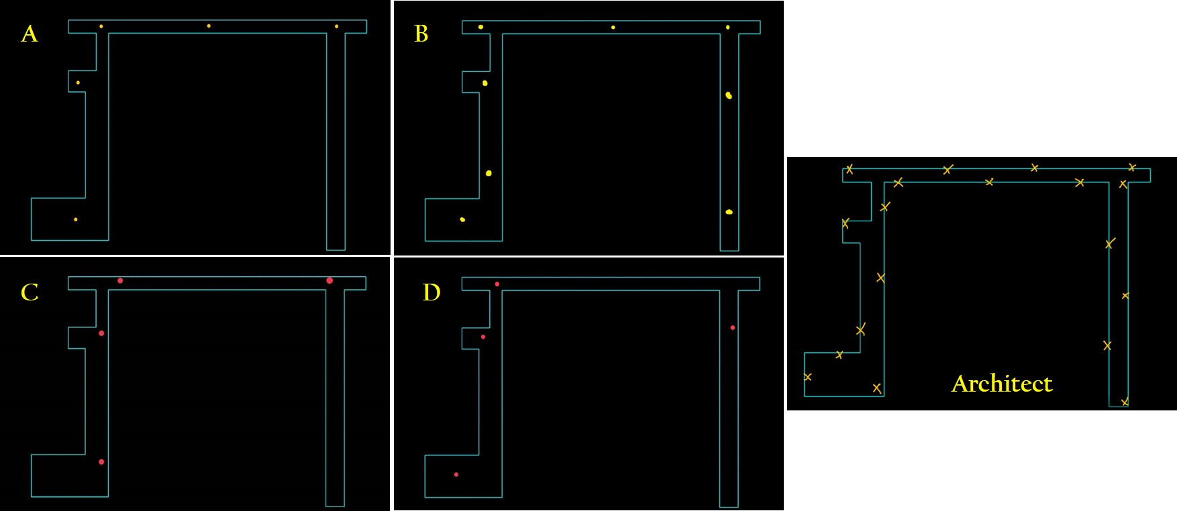
User Studies – No limit

Slide 21
User Studies – angle and distance constraint

Slide 22
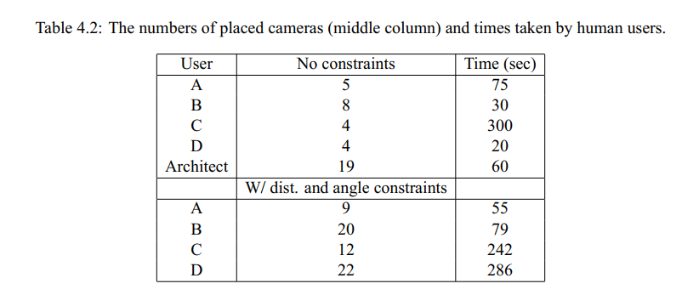

Slide 23
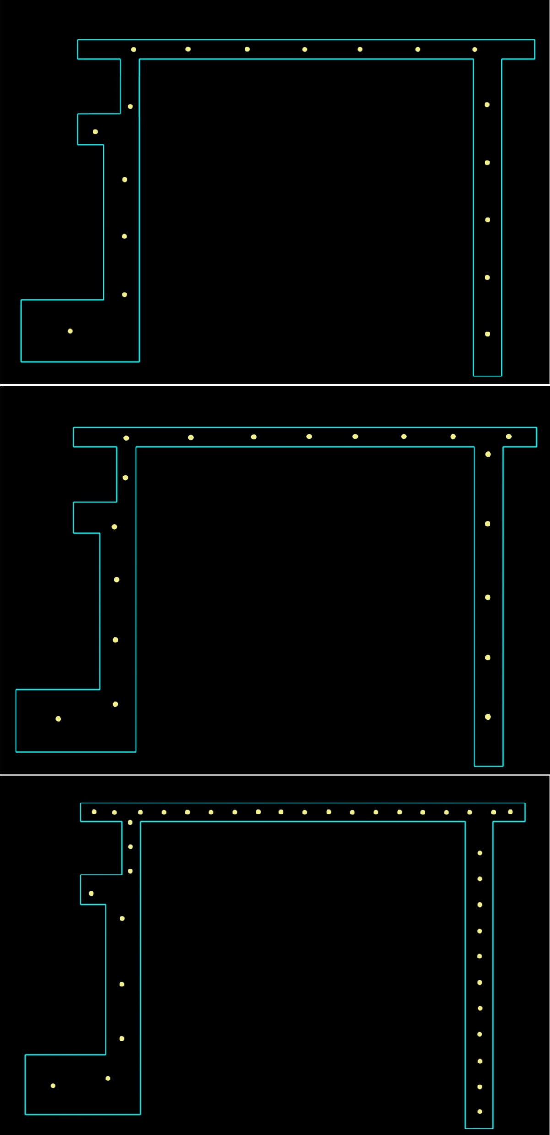
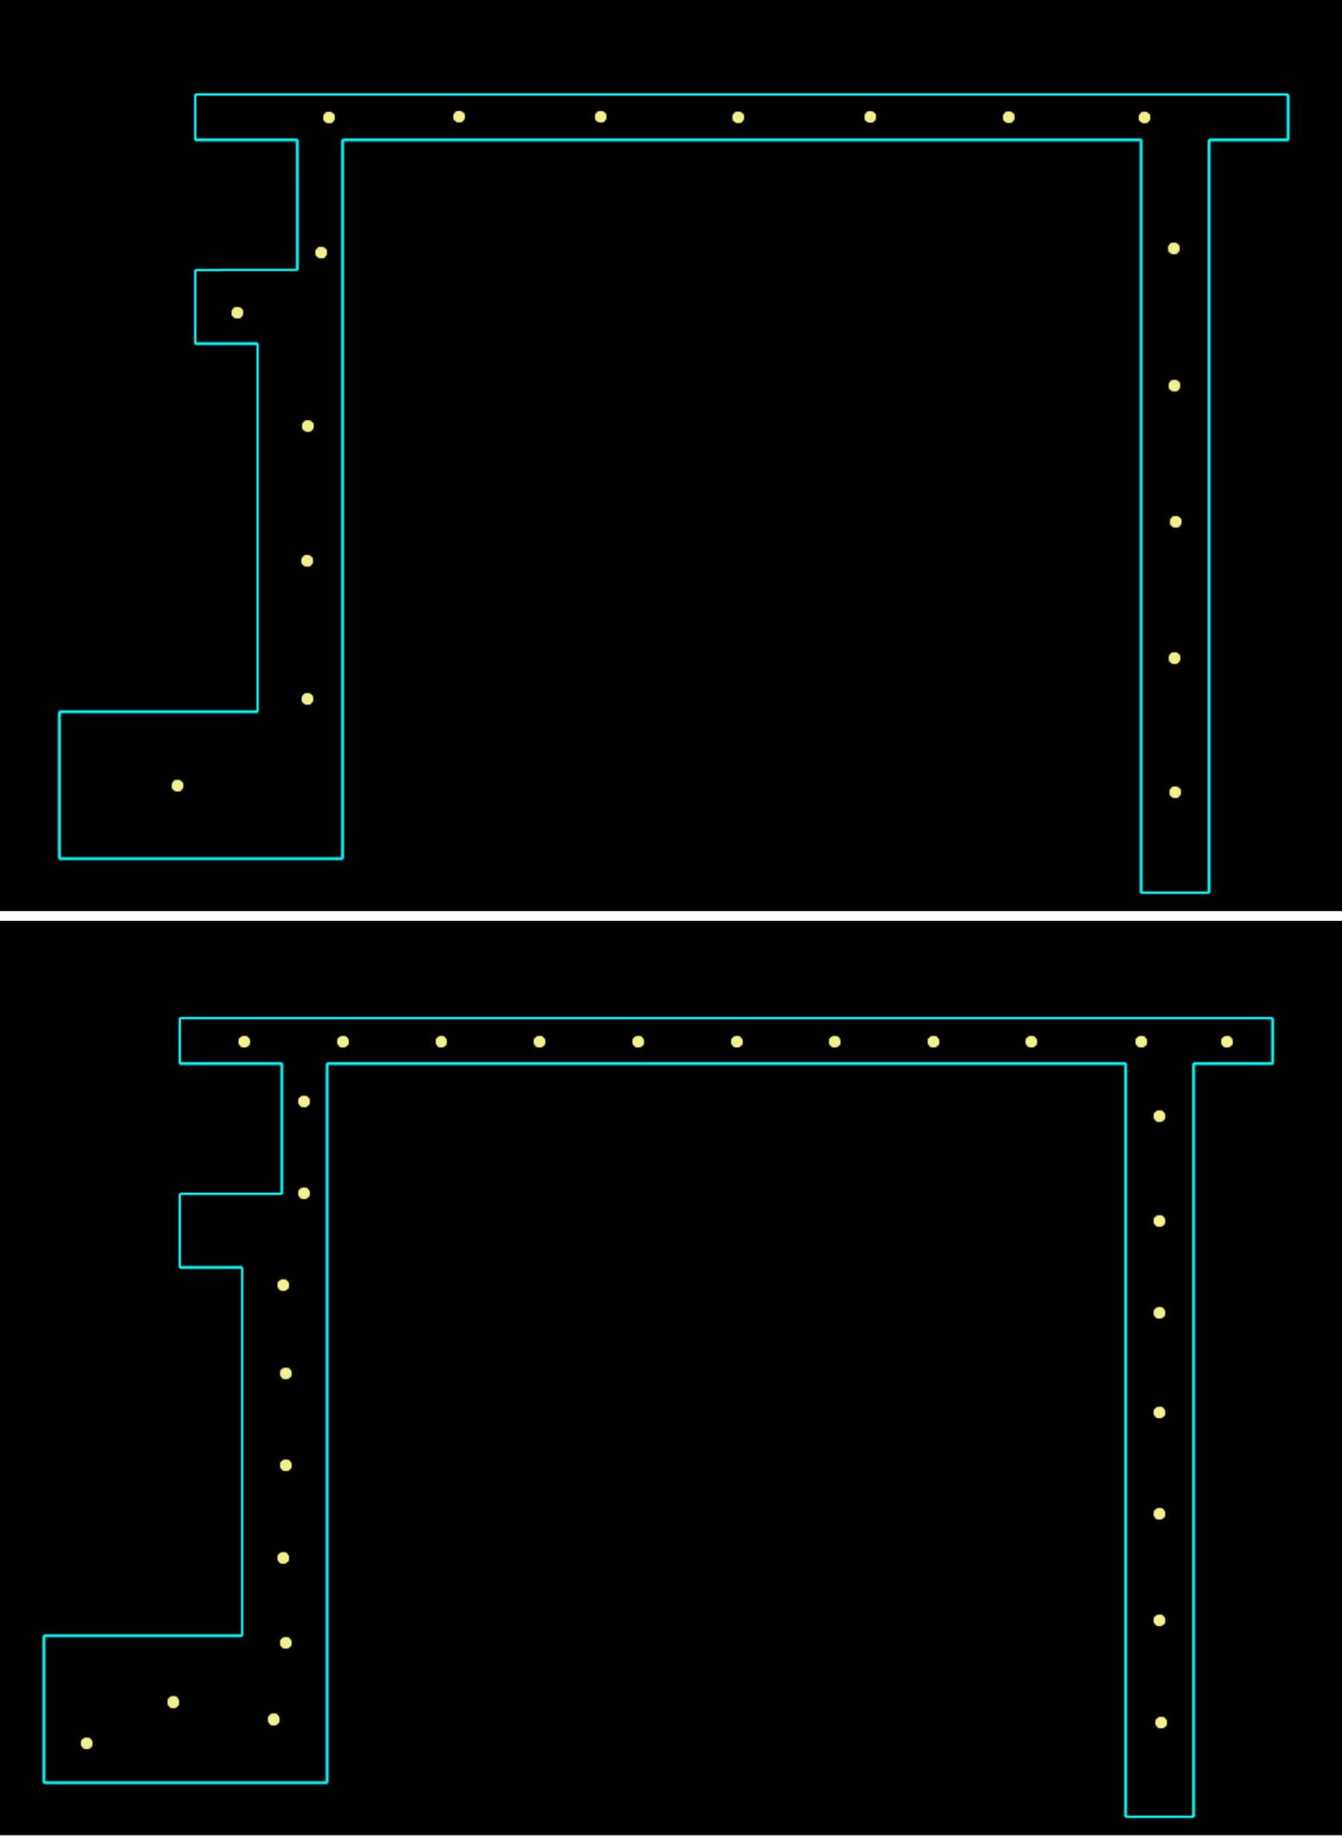
Based-on same max distance
Based-on same angle
The figure from top to bottom is the result optimized in our approach at 5.04 meters and 3.36 meters.
The figure from top to bottom is the result optimized in our approach at 90◦, 67.5◦, and 45 ◦

Slide 24
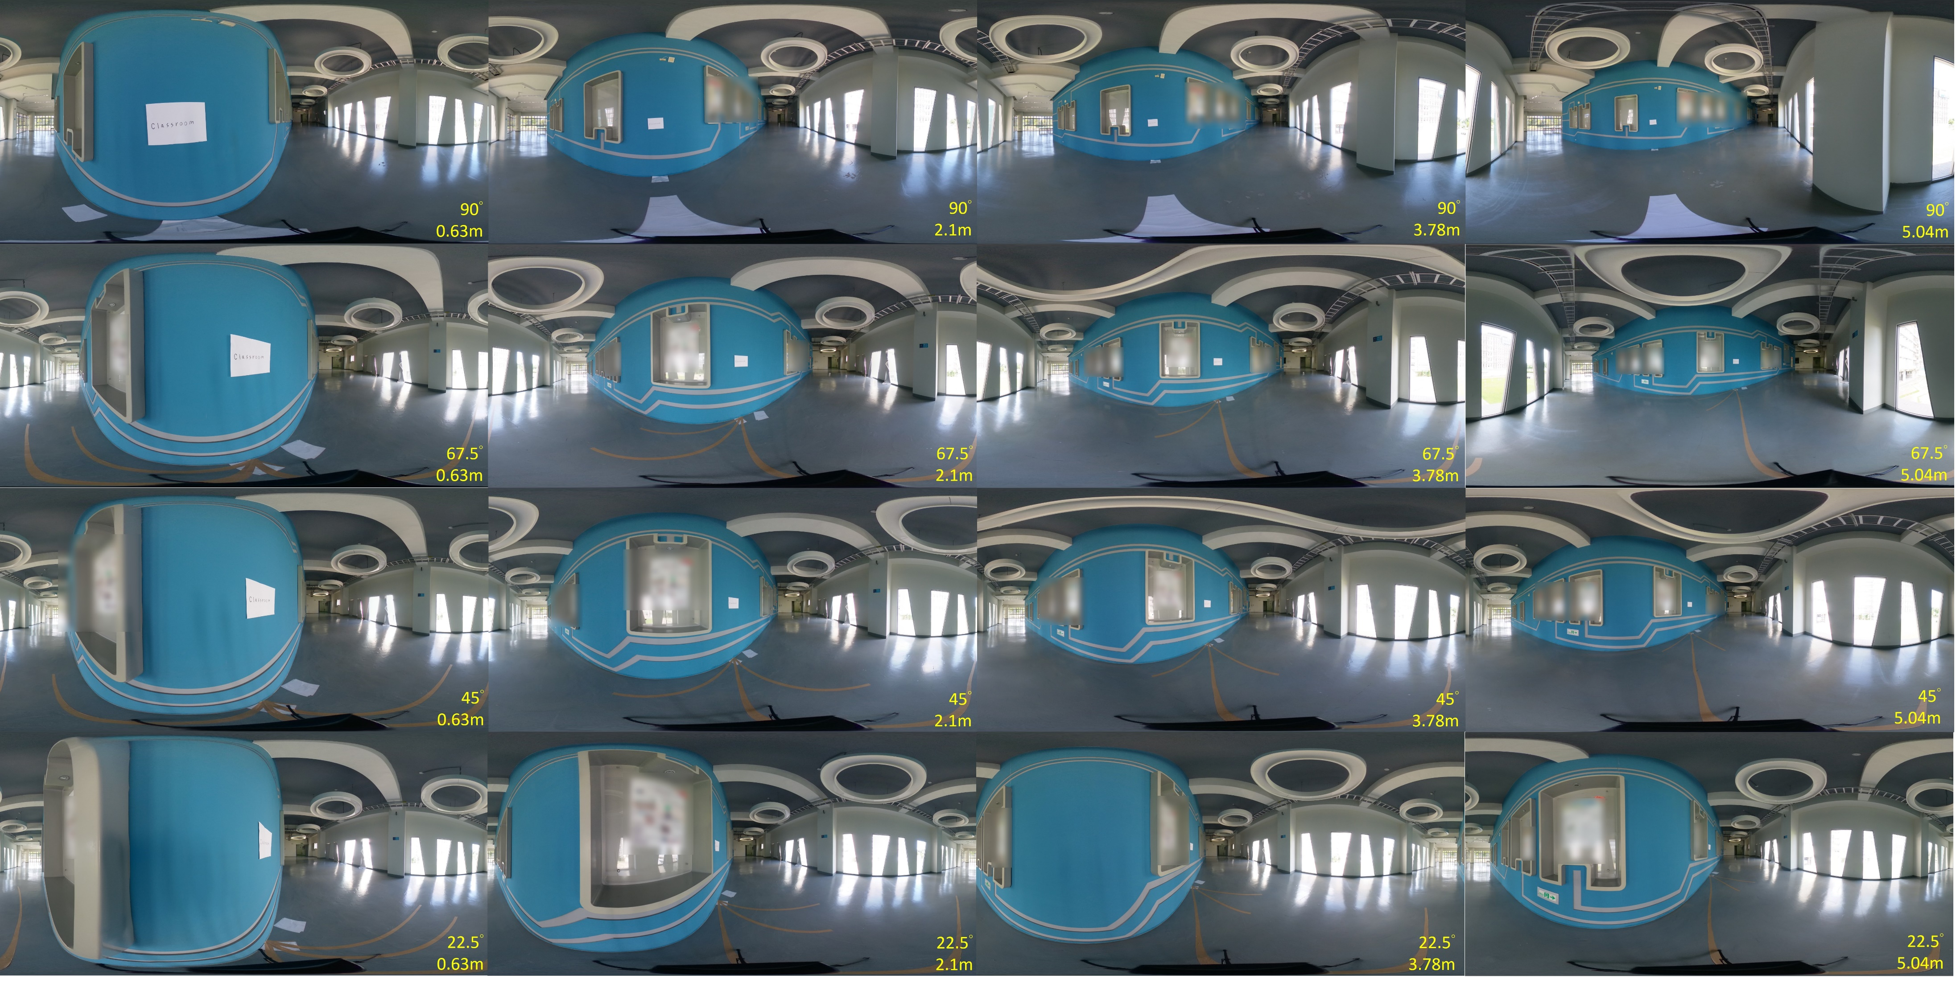

Slide 25
Conclusion
Use the circular ray sweeping based algorithm to enumerate visible interior points of a boundary point.
Formulate the set covering problem as a simple integer-programming (IP) problem that can be readily solved by modern solvers such as Gurobi.
A first step toward professional solutions for the AEC industries.

Slide 26
Future Work
Expand our methods to accommodate more realistic 3D models of the indoor environments and the 360◦ cameras.
Incorporate more real-world issues about 360◦ photography:
planning the paths of moving the camera/tripod
deviations of the camera heights

Slide 27
Q & A

